Slide 1
CS 330 Case Study Part I
Annie Lin, Jiayi Hao, Ken Ye, Amy Yin

Slide 2
Group Member Contribution
Annie Lin
  Edited and debugged algorithms for task 1 and task 3 based on Amy’s initial design
  Wrote algorithm descriptions for task 1 and 3 and answer other questions of these two tasks
  Created slides for task 1 write-ups
Ken Ye
  Designed and implemented algorithms for task 2 and ran test cases on dataset
  Slides for task 2 algorithm description and runtime
Jiayi Hao
  Proofread task 2 algorithms and fixed experimental results
  Finished part 2 of task 3 testing and fixed visualizations
  Created slides for rest of task 2 and task 3
Amy Yin
  Designed and implemented algorithms for task 1 and 3
  Finished examples/tasks/test cases for task 1 and 3

Slide 3
Task 1

Slide 4
Q1 Density Function
Task 1: Identifying the Hubs
The function density finds the number of points in a given neighborhood, whose size is manually determined and should be relatively small.
Reason for choosing the function:
  We choose this function because counting the number of points in a small neighborhood has smaller time complexity, and because the sizes of the neighborhoods are equal, we are able to compare the density of different neighborhoods (which we can use to find hubs later).
Parameters:
  The function has parameter point. This point is the center of a neighborhood and represents the neighborhood.
  The other parameter is the size of neighborhood in grid unit.
    With these two parameters, we can locate the range of the neighborhood on the grid.
Example:
  Suppose we have a 100 x 100 grid, and we decide to have 20 x 20 = 400 neighborhoods. Then, each neighborhood will be squares of size 100/20 x 100/20 grid units. The density of each neighborhood will be the number of points found in each of these squares.

Slide 5
Q1 Preprocessing & Density Algorithm
Preprocessing
  To represent all points, we use a 256 x 256 grid bounded by min(x) and max(x) from dataset.x for the x-axis of the grid, and by min(y) and max(y) from dataset.y for y-axis.
    In implementation, the structure of the grid is a list of dictionaries with key as grid indices and value as points in our set on that specific location.
  The function get_grid returns the relative location of a point in the grid by calculating the relative scale of the grid unit to real world distance with unit km.
    (One unit in the x-axis of the grid represents stride_x km, and one unit in the y-axis represents stride_y km.)
    Applying get_grid to all points in the dataset, we are able to plot them onto the grid.
  We used uniformly-distributed neighborhood on the plane to approximate the hubs. We use The grid is also divided into 50 x 50 equal-sized neighborhoods (each neighborhood is of size 256/50 x 256/50) which is the basic unit for density we have defined.
  The runtime complexity of preprocessing is O(N), as plotting all points onto the grid requires looping through all points, and everything else is of constant time.
Density
  As described before, density returns the number of points that are within a size s neighborhood.
  In implementation, we first calculate nearby_grids, or where the neighborhood starts and ends on the x-axis and the y-axis of the grid.
  Then, we obtain the number of points in each grid of nearby_grids (which is the value of dictionary with grid indices as key), and store all points in a list. The length of the list is the density of the neighborhood.
  Because density ends up visiting all points in the neighborhood, the runtime complexity is O(m) with m equal to the number of points in the neighborhood.

Slide 6
Q2 Hubs Algorithm
In this function, we will select k high density hubs among the 50 x 50 neighborhoods we previously divided. We call density for each neighborhood to obtain the number of points in each neighborhood, and sort the neighborhoods by their densities, from the highest to the lowest.
  Runtime Complexity
    Calling density once is constant time here because we are only visiting a neighborhood with a small number of points. Since we are calling density for each neighborhood, however, we end up visiting all points in the dataset. So the for loop of calling density on each neighborhood adds up to an O(n) runtime.
    Note that the sorting step will cost O(m log m) for m = 2500 (the number of neighborhoods), which is significantly smaller than the total number of data points. So the complexity of this step can be estimated as constant time.
We then use a greedy algorithm to calculate the k high density hubs. In the greedy algorithm, we iterate through the neighborhoods in the sorted order, and add a neighborhood to a set (declared before iteration has started) if the euclidean distance between that neighborhood and all other neighborhoods in the set is greater than r. We will stop the iteration once we have k hubs in the set.
  Runtime Complexity
    This step has time complexity upper-bounded by O(m) for m = 2500 and we will actually not loop through all the neighborhoods.
    Therefore, the total runtime of hubs is O(n) (the complexity of running density in all neighborhoods).

Slide 7
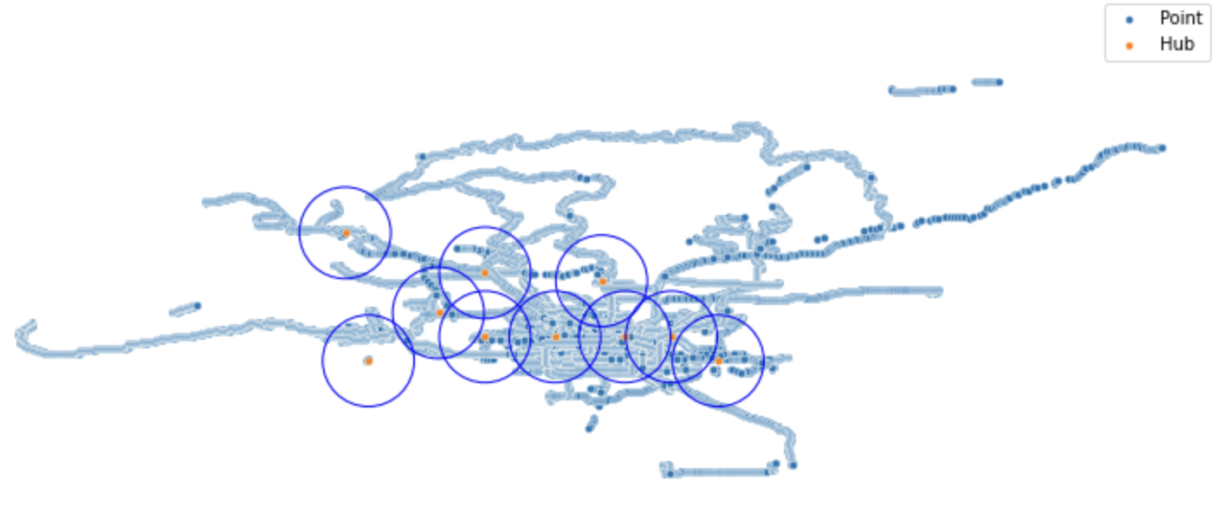
Q3 Experimental results
Result 1
Preprocessing time: 847 ms
Result 2
k | 5 | 10 | 20 | 40
Runtime (without preprocessing) | 225.10 | 195.89 | 217.59 | 219.74
Runtime (with preprocessing) | 1072.10 | 1042.89 | 1064.59 | 1066.74
Result 3
Sample | 10% | 30% | 60% | Full
Runtime (without preprocessing) | 246.49 | 282.82 | 332.52 | 406.94
Runtime (with preprocessing) | 1093.49 | 1129.82 | 1179.52 | 1353.94

Slide 8
Q4 Algorithm Evaluation
Total runtime
  The runtime for all computations combined, including preprocessing O(N), density calls O(1) in neighborhood and O(N) in total, and hubs algorithm O(N), is O(N).
Benefits
  By dividing the entire trajectory into equal-sized small neighborhoods and choosing the k-highest hubs from them, we significantly reduced the runtime of the function hubs – we only have to consider neighborhoods, whose number is significantly lower than the total number of trajectory points.
  Calling density is of constant time in a small neighborhood – the density function counts the number of points in a small neighborhood, and in general, the number of points in a small neighborhood is limited.
Drawbacks
  Because the density function relies on approximation and the size of the neighborhood is manually determined, we cannot guarantee that we use the most optimal neighborhood size.
    For example, if the size is too big, each neighborhood might contain more than one hub, and we are likely to miss high density hubs in the same neighborhood.
    On the other hand, if the size is too small, then the number of neighborhoods will be large, and this can impact the runtime as we will loop through all neighborhoods in the hubs function.
Further improvement
  Our approximation assumed that the points on the plane are uniformly distributed on the plane, but the points are not uniformly distributed with large density differences. We hope to find a better data structure to help us approximate the hubs that can solve this issue. K-d trees can be one possibility, if we can satisfy the runtime requirements.
  We hope to find an algorithm that calculates and sorts all densities of the input points, satisfies the runtime requirements, and does not reply on approximation.

Slide 9
Task 2

Slide 10
Task 2: Proposed Algorithm
d(q,e): computes the distance between a point q and a line segment e(a,b). We project vector aq onto vector ab. When projection <= 0: q is closest to a, we compute distance between q and a; projection > 1: q is closest to b, we compute distance between q and b; when q is closest to its projection on e: we compute distance between q and its projection on e
TS_greedy(T, eps): computes an epsilon-simplification of the trajectory T
  Base Case: |T|< 3. The trajectory cannot be simplified further, so T is returned.
  When |T|>=3, we initialize the simplified trajectory, T_star, with the first and last points of the trajectory. We find the point q in T furthest away from the segment constructed by the first and last points of the trajectory (T_star) by calling d(q, T_star).
  If d(q, T_star) ≤ ε, then T_star is the ε-simplification of T since T_star can represent T within max error ε. Return T_star
  Otherwise, d(q, T_star) > ε, we recursively call TS_greedy() on left and right parts of T that are split by q, and add the results together.
Runtime: O(|T|log|T|)
  d(q,e): O(1). Constant time computation of Euclidean Distance.
  TS_greedy(T, ε): O(|T|log|T|) with recurrence relation T(n) = 2T(n/2)+nO(1)
    We traverse T to find q in O(N) time per function call
    We recursively call on divided parts of T which results in O(log|T|)

Slide 11
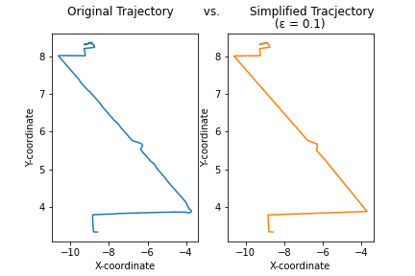
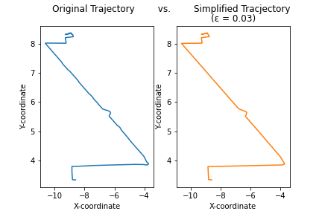
Results: Simplifications of Trajectory 128-20080503104400 with Different ε values
ε = 0.03
ε = 0.1

Slide 12
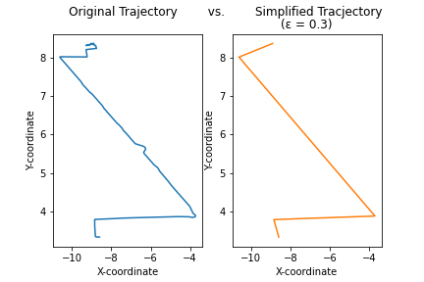
（Continued） Simplification of Trajectory 128-20080503104400
ε = 0.3
Report of Compression Ratio (|T | /|T ′|) for 4 Trajectories (ε = 0.03)
Trajectory ID | 128-20080503104400 | 010-20081016113953 | 115-20080520225850 | 115-20080615225707
Compression Ratio | 10.03 | 27.15 | 19.56 | 21.21

Slide 13
TS_Greedy Algorithm Evaluation
Advantages:
  Our algorithm runs in desired runtime to find an epsilon-simplification of a given path.
  Our algorithm optimizes based on different epsilon values
Drawbacks and future improvements:
  Our current optimization strategy can be improved. Currently, we preserve T_star, saving the first and last points of the segment. We plan to take advantage of point q(point with max distance from T_star segment) and connect this point to other similar q points in other segments of T to further optimization simplification.
  We can utilize data structures (specifically, dynamic convex hull data structures specifically designed for dynamic geometry computation) to store information about segments of T paths and to speed up our algorithm.

Slide 14
Task 3

Slide 15
Task 3: DP Algorithm to Compare Trajectory
Case 1: use σ_{avg} as the score (DTW)
Create a m by n table dp with m = 1 + |P| and n = 1 + |Q|. This time, each cell of the table will store:
∑^{E} d²(p,q) for (p,q) ∈ E up until this cell
Dependency of the current cell, i.e., the previous cell on which the information of the current cell is dependent. (This previous cell will either be the cell left to it, above it, or upper-left to it, because our iteration begins from the upper left corner.) Initialization: dp[0][0] = [0, None]. The recurrence relation is as follows:
curr = dp[i][j]:
curr[0] += d²(p,q)
if curr[0] < dp[i + 1][j][0]: dp[i + 1][j] = [curr[0], (i, j)]
if curr[0] < dp[i][j + 1][0]: dp[i][j + 1] = [curr[0], (i, j)]
if curr[0] < dp[i + 1][j + 1][0]: dp[i + 1][j + 1] = [curr[0], (i, j)]
Base case: We initialize dp[0][0] with 0 and fill the rest of cells with ∞. Then, we iterate through the entire table, using the recurrence relation stated above. Therefore, from the cell dp[m-1][n-1], we can retrieve ∑^{E} d²(p,q) of the entire path as well as information about the path. To get the path, we simply follow the dependency that we have established earlier and travel backwards to retrieve all cells being dependent on, until we reach dp[0][0]. Finally, to calculate σ_{avg}, we simply perform ∑^{E} d²(p,q) / |E|.

Slide 16
DP Algorithm Explanation (Cont.)
Case 2: use σ_{max} as the score (FD)
Similar to Case 1, we create a m by n table dp with m = 1 + |P| and n = 1 + |Q|. This time, each cell of the table will store:
σ_{max} = max d(p,q) for (p,q) ∈ E up until this cell
Dependency of the current cell. The recurrence relation is as follows:
dp[0][0] = [0, None]
For curr = dp[i][j]
curr[0] = max(curr[0], d(p,q))
dp[i + 1][j] = [curr[0], (i, j)] if curr[0] < dp[i + 1][j][0]
dp[i][j + 1] = [curr[0], (i, j)] if curr[0] < dp[i][j + 1][0]
dp[i + 1][j + 1] = [curr[0], (i, j)] if curr[0] < dp[i + 1][j + 1][0]
We initialize dp[0][0] with 0 and fill the rest of cells with ∞. Then, we iterate through the entire table, using the recurrence relation stated above. Therefore, from the cell dp[m-1][n-1], we can retrieve σ_{max} of the entire path as well as information about the path, as what we have done earlier.
Both space and time complexity is O(|P| · |Q|) because the tables we create are of size |P| · |Q|, and we iterate through each cell exactly once and fill it. The while loop only iterates through cells that have dependencies and has time complexity O(m) for m equal to |E|, so O(m) < O(|P| · |Q|) and does not affect the big O runtime. Everything else is of constant time.

Slide 17
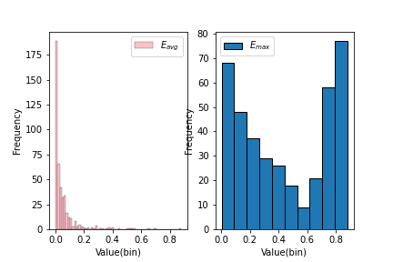
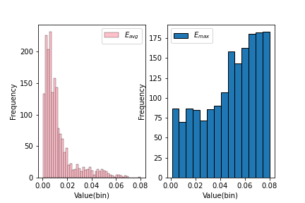
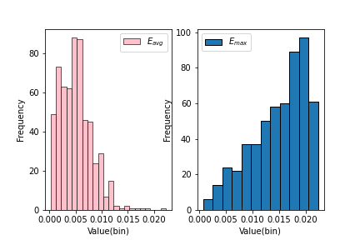
Task 3 Results: Eavg & Emax or T pairs
Trajectory pair: (128-20080503104400, 128-20080509135846)
Trajectory pair: (115-20080520225850, 115-20080615225707)
Trajectory pair:
(010-20081016113953,010-20080923124453)

Slide 18
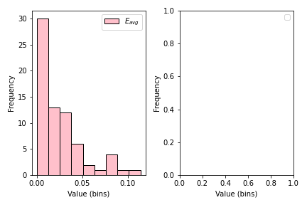
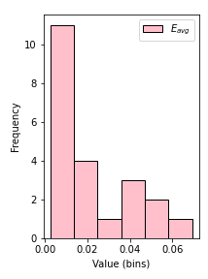
Task 3 Results: Eavg of T1ε and T2ε
T1 = 115-20080520225850, T2 = 115-20080615225707, ε = 0.03,0.1,0.3 (km)
ε = 0.03
ε = 0.1
ε = 0.3

Slide 19
DP Algorithm Evaluation
Advantages:
  The current algorithm is easy to understand and readable as it follows transition formulae that are clear and simple
  The current algorithm is comparatively fast (it’s runtime is a sum of the inputs’ sizes)
Drawbacks:
  The current algorithm utilizes a lot of space to store information. The DP table takes up much space when the input trajectories are of a large size
  Future Improvements:
  space optimization: We want to explore ways in which we can optimize our current space complexity by re-using spaces in our DP table (potentially re-writing values no longer needed for computation)

